Slide 1
How does class size affect academic performance: Evidence from primary schools in Israel
Yiran Liu, Alvin Jiao, Ron Huang

Slide 2
Introduction
Parents and teachers generally report that they prefer smaller classes because those involved with teaching believe that smaller classes promote student learning and smaller classes offer a more pleasant environment. We will use the data of the 4th and 5th grade students of more than 2000 primary schools classes in Israel. We want to use machine learning models to assess the relationship between class size and academic performance in primary school and compared to the results Refer to the paper “Using Maimonides’ Rule to Estimate the Effect of Class Size on Scholastic Achievement” which uses linear models.
Is small class or large class more beneficial for pupils’ academic performance?
Is the relationship between class size and educational performance linear?

Slide 3
Set up
Variables of Interest
Enrollment and class sizes (X)
Avg. test scores (y)
% disadvantaged students
Replication of original study (2 Stage Least Squares)
Polynomial Regression and k-fold cross validation
On both 4th and 5th Grade
CV on both to pick optimal degree
Bootstrap to calculate std. and compare results with 2SLS
KNN and k-fold cross validation
On both 4th and 5th Grade
CV on both to pick optimal k
Compare bootstrapped standard error and coefficients with 2SLS

Slide 4
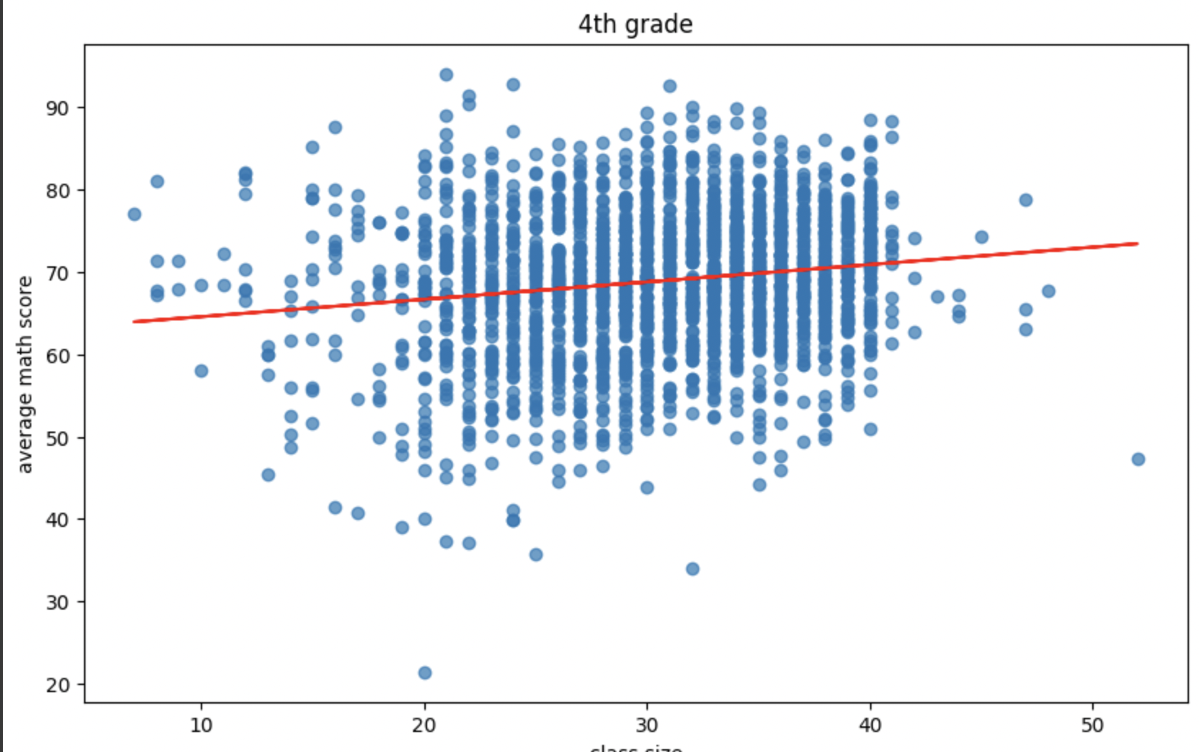
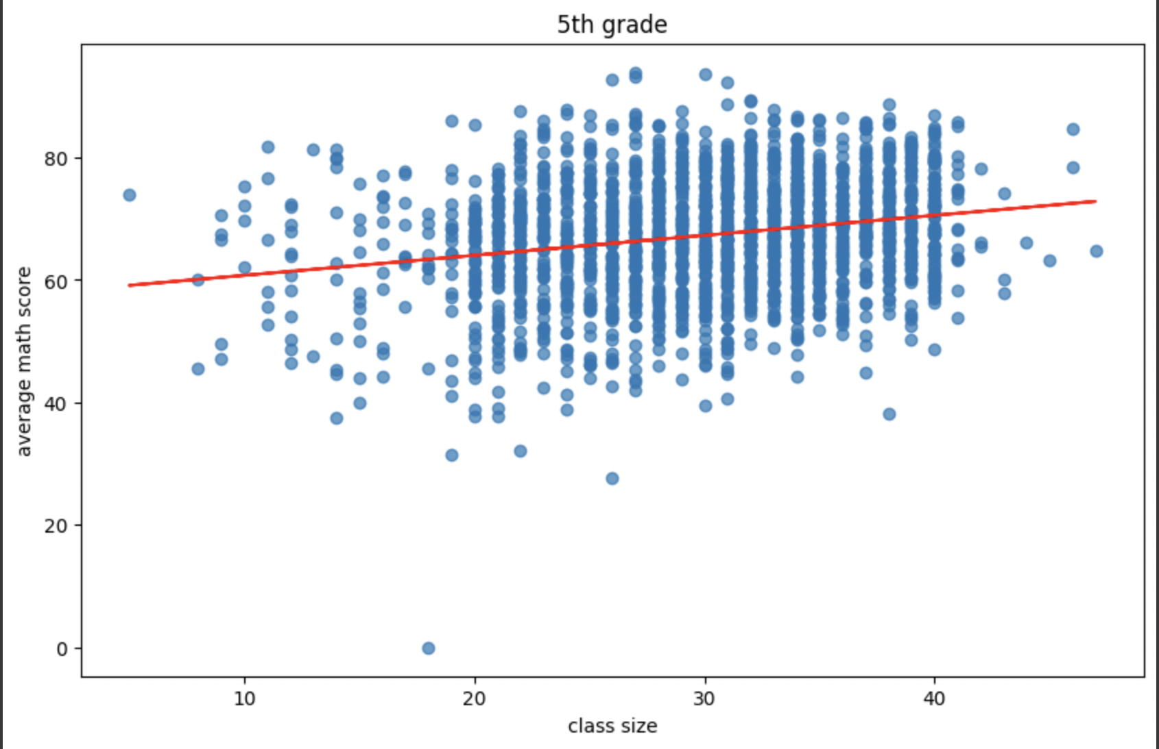
OLS - Class size & average math scores
Observation:
OLS generally shows positive correlation between class size and test score (larger class has better performance on test)
After we add controls, the positive correlation is reduced, but still positive, which does not correspond with our intuition.

Slide 5
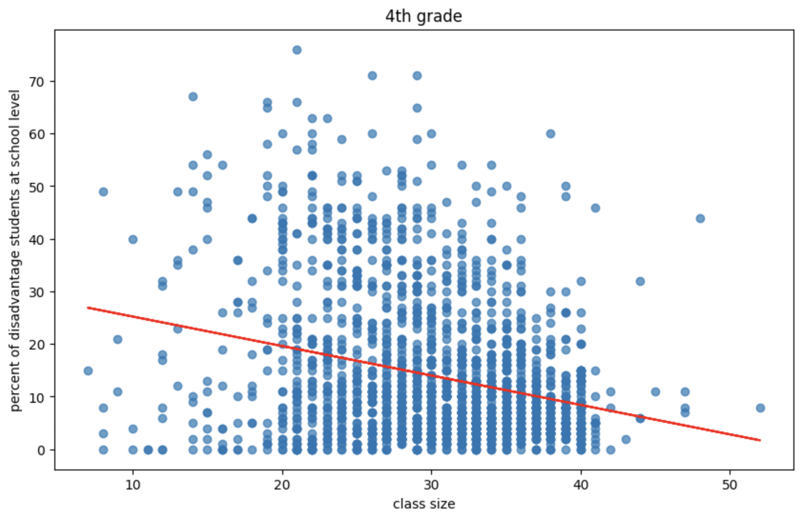
Bias of OLS
Greater class size -> less disadvantaged students

Slide 6
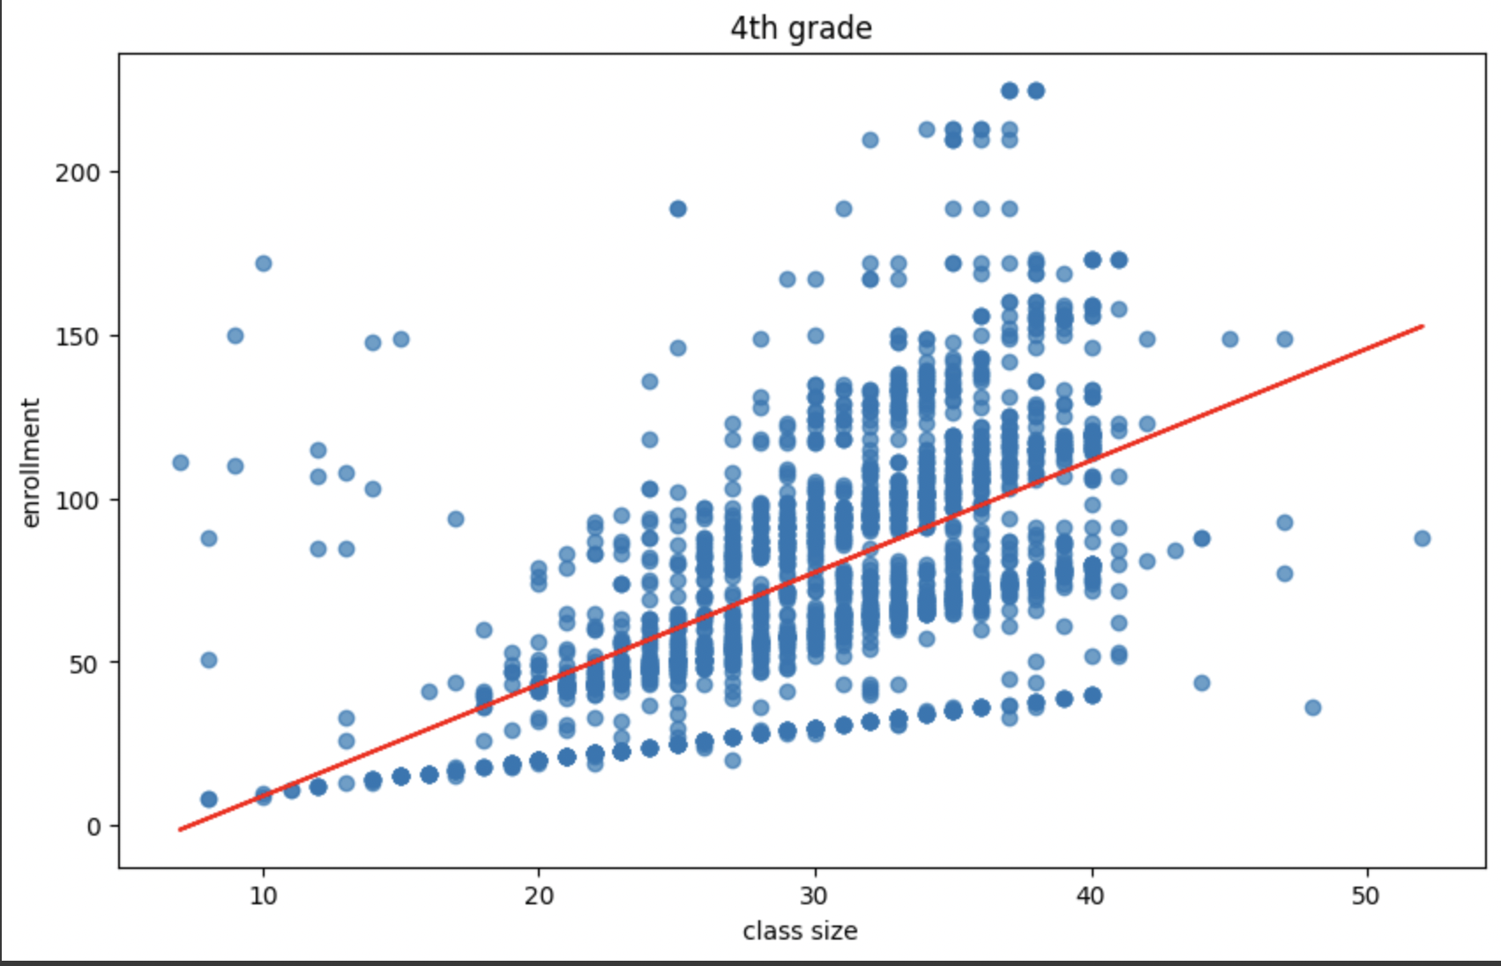
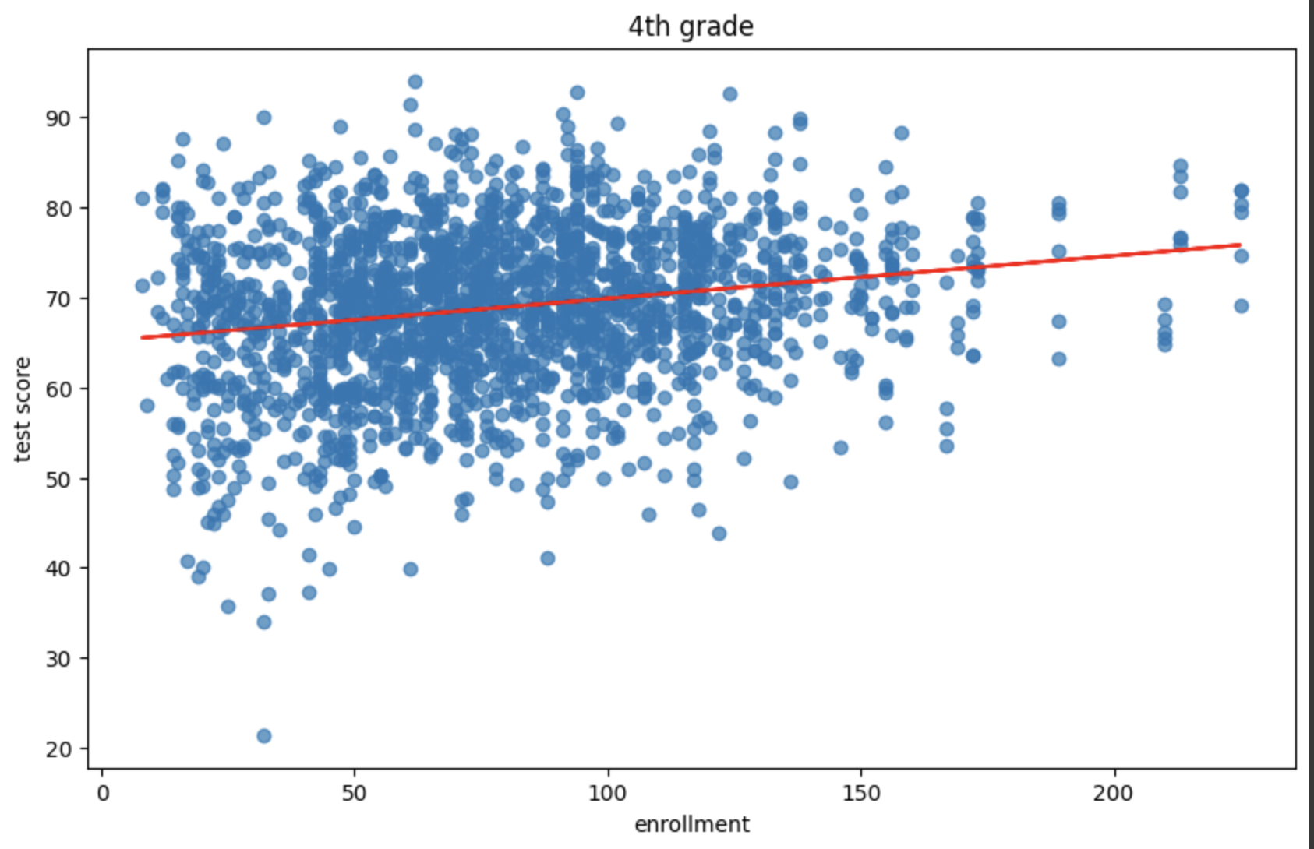
Bias (Cont.)
Bigger schools tend to have greater class size and better test scores.
Notes:
Two reasons:
1. percent disadvantage variable only track the number of disadvantaged students at the school level, not at the class level within schools, so PD does not explain all the nonrandom selection of students in difference size of class.
2. Background info: school principals may group children who are having trouble with their schoolwork into smaller classes, but since we do not have data on the number of disadvantaged students at the class levle, we are unable to control for this covariate.

Slide 7
Why does OLS fail
Two reasons:
percent disadvantage variable only track the number of disadvantaged students at the school level, not at the class level within schools, so PD does not explain all the nonrandom selection of students in difference size of class.
Background info: school principals may group children who are having trouble with their schoolwork into smaller classes, but since we do not have data on the number of disadvantaged students at the class level, we are unable to control for this covariate.

Slide 8
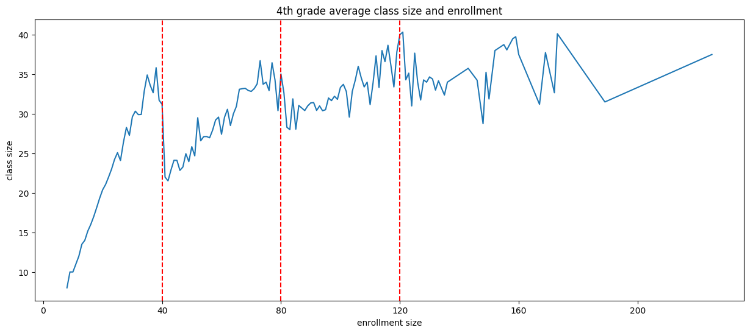
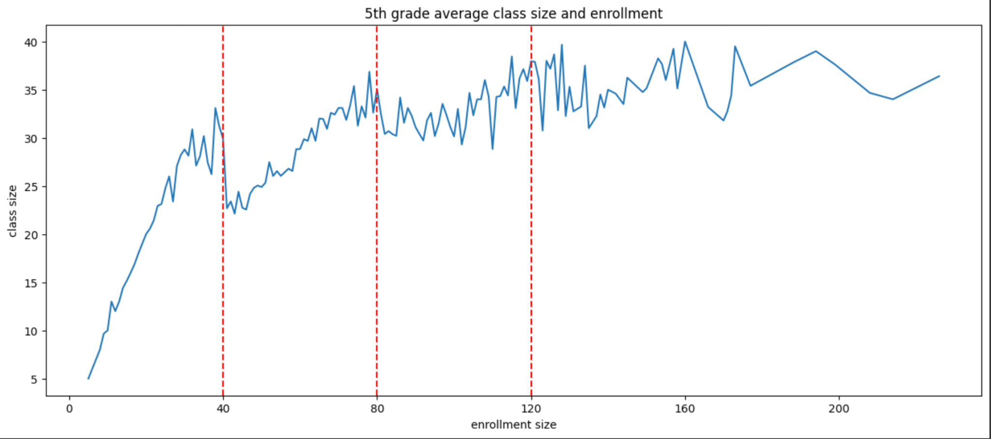
Another Way Out – RDD
Notes:
The paper has another way out: the RDD, which stands for regression discontinuity design. There is an interesting phenomena in the data – when the total enrollment size exceeds 40 students, schools will form 2 classes with about 20 students in each class. Therefore, RDD is plausible in this scenario since with enrollment size near 40 (for example 39 will be a large class size while 41 will be considered as small class size since the school is likely to split them into 2 classes of 20). Therefore, the cutoff point is selected as 40 since at this point the difference of class size is larger than that of 80 or 120.

Slide 9
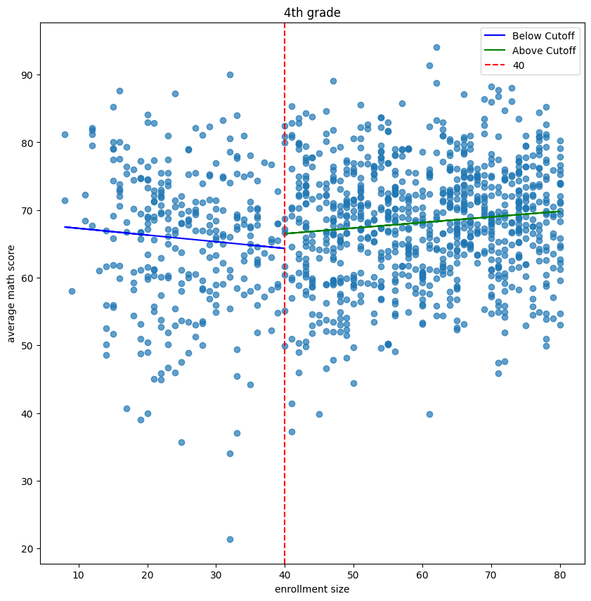
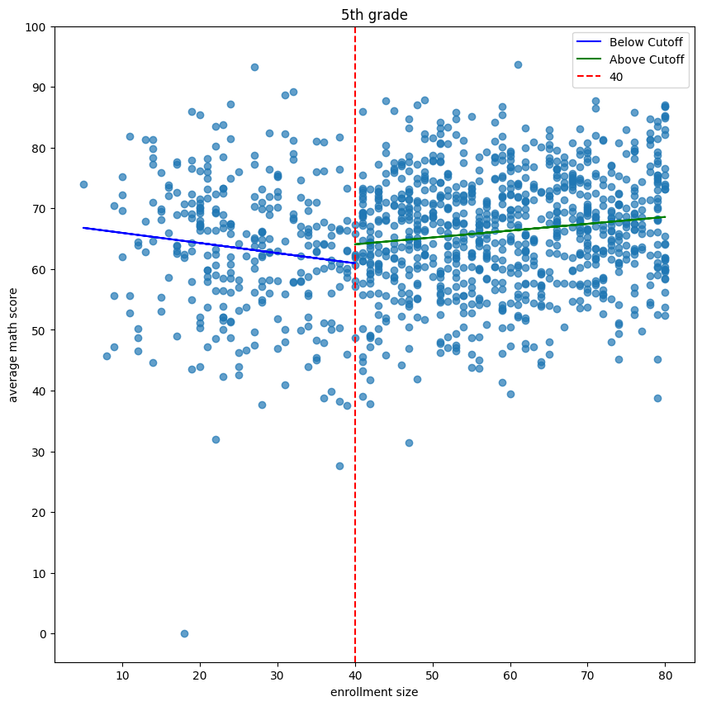
RDD Using Linear Model

Slide 10
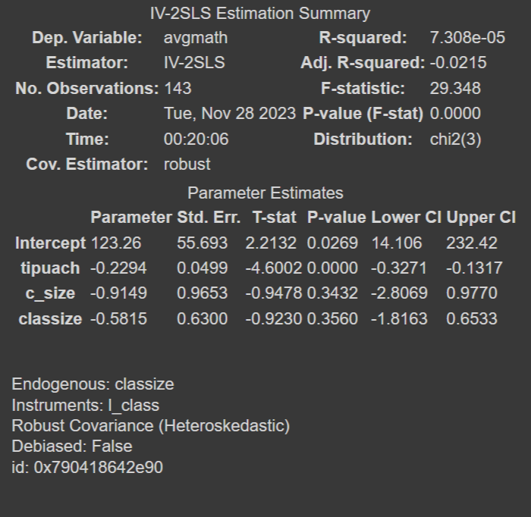
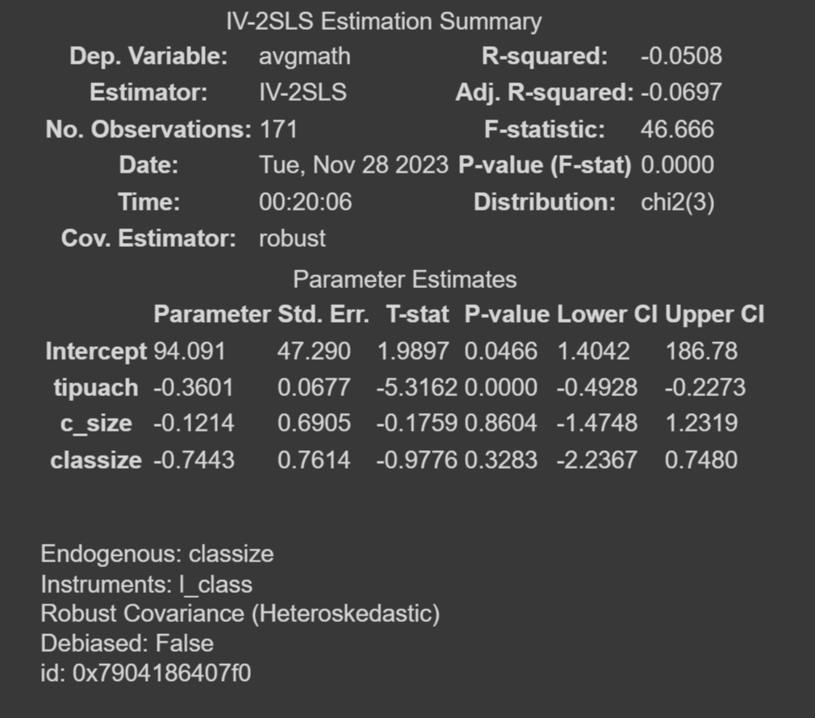
2 Stage Least Squares
Extension of OLS, still assumes linearity
Adopted by the original paper
4th Grade
5th Grade

Slide 11
Apply machine learning tools
Main issue with using linear model:
strong assumption on the relationship between variables, which could be wrong.
In other words, linear model provides a better sense of the general trend but cannot capture the local variations well, causing inaccurate estimation of the average test score near the cutoff. And this directly affects our final estimation of the treatment effect
By using machine learning tools:
We can reduce the error of estimation by selecting the best model that fits the data points, and therefore get a better estimate of the treatment effect.

Slide 12
Polynomial Regression

Slide 13
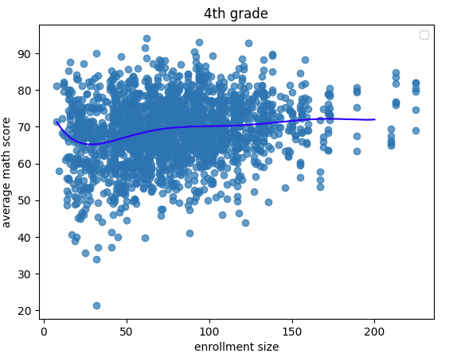
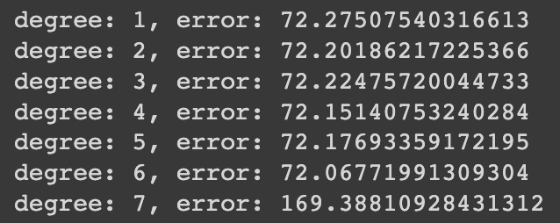
Full Sample
Optimal degree = 6 by CV
Confirms that linearity does not hold

Slide 14
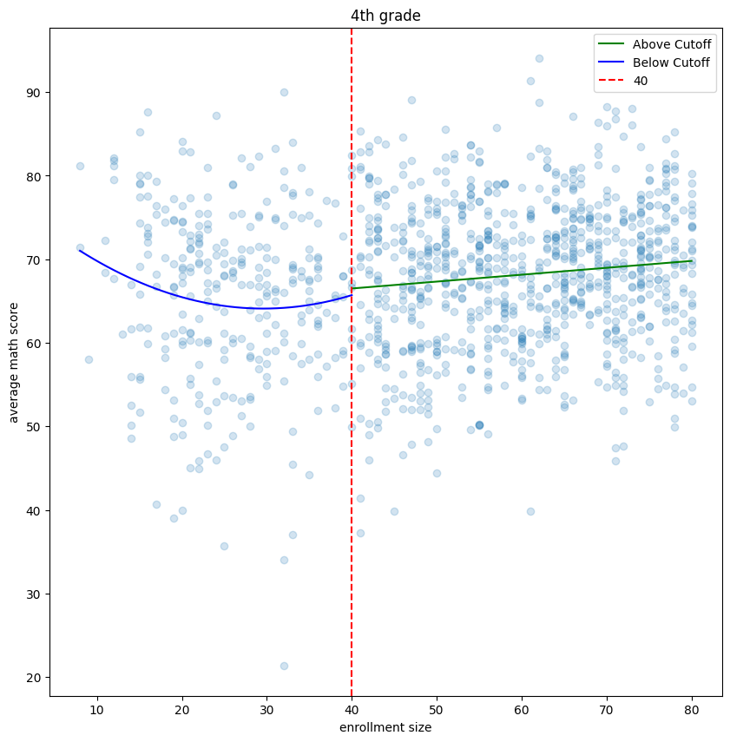
4th Grade
By k-fold CV…
Below cutoff: Degree = 2
Above cutoff: Degree = 1
Model Coef = -0.98
Stronger than 2SLS Coef (-0.58)
By Bootstrap…
Std. = 1.5247
mean = -1.0064
-1.0064/1.5247, not significant

Slide 15
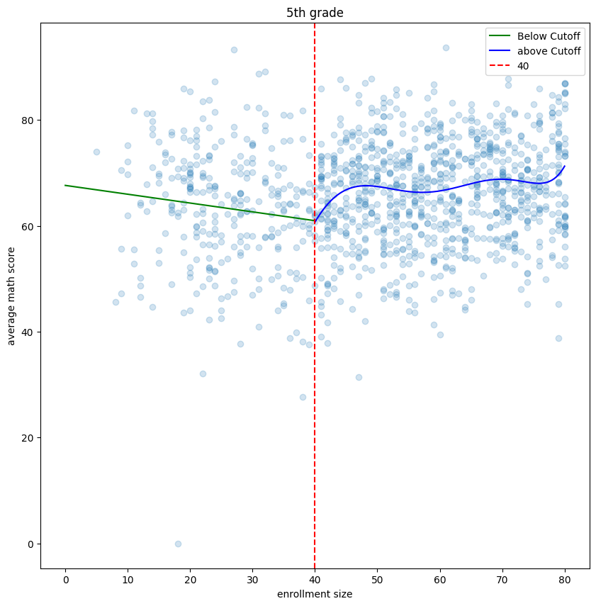
5th Grade
By k-fold CV…
Below cutoff: Degree = 1
Above cutoff: Degree = 6
Model Coef = -3.76
Stronger than 2SLS Coef (-0.74)
By Bootstrap…
Std. = 1.4678
Mean = -3.790
-3.790/1.4678, significant local treatment effect

Slide 16
K-Nearest Neighbors Regression

Slide 17
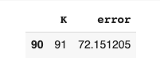
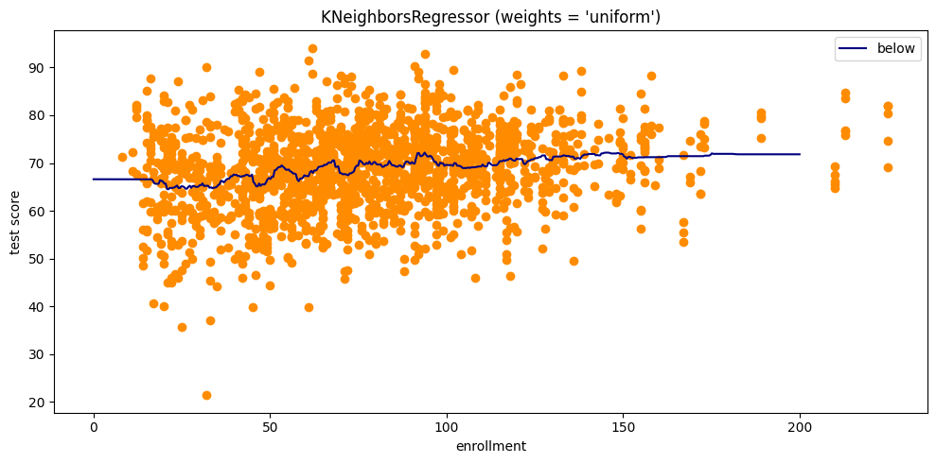
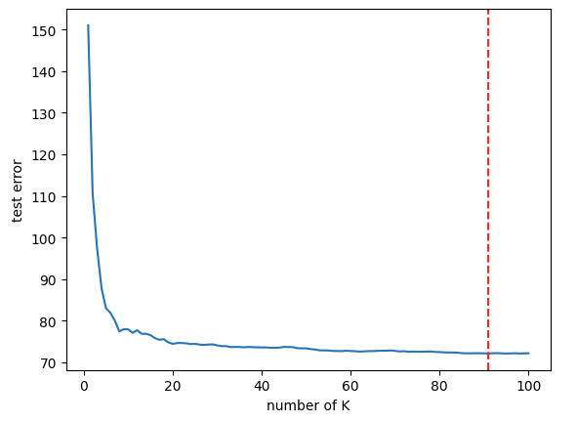
KNN Regression

Slide 18
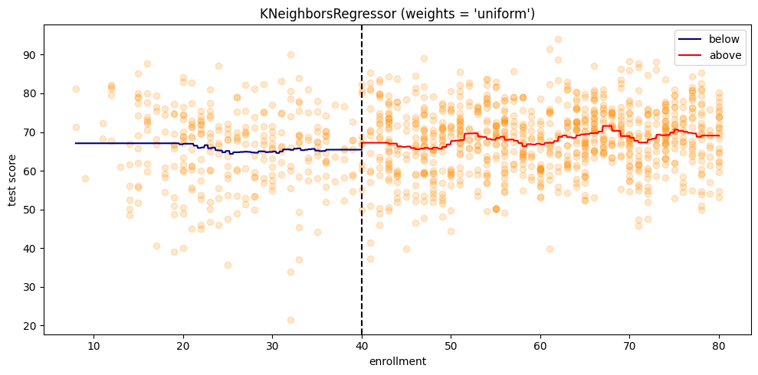
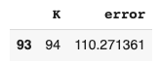
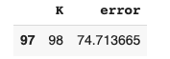
4th Grade
Model coef= -1.640
By Bootstrap:
SE=1.4739
Best K for Below Best K for Above
b

Slide 19
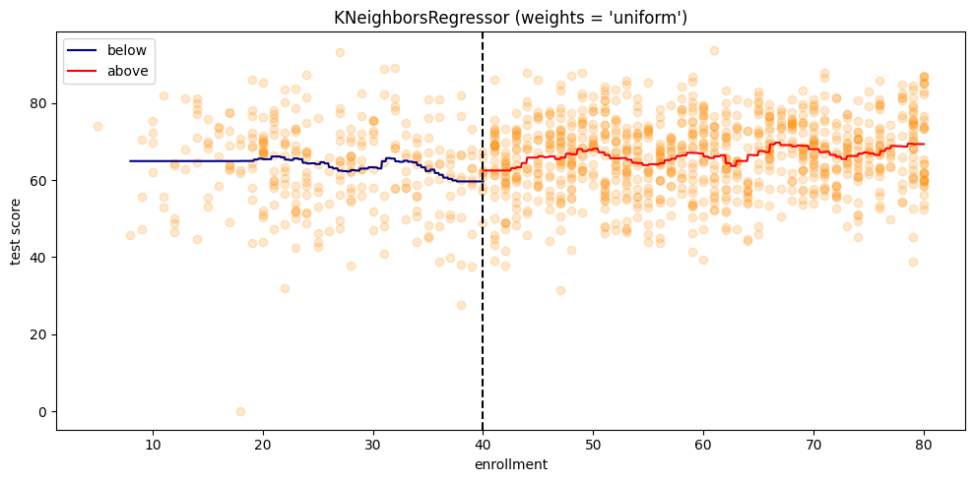
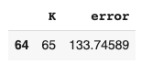
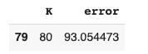
5th Grade
Model coef= -3.358
By Bootstrap:
SE=1.631
Best K for Below Best K for Above

Slide 20
Conclusion
KNN and polynomial regression have similar performance when fitting this dataset (polynomial regression slightly outperforms KNN: test MSE 80.0427 compared to 81.1014)
Nonlinear relationship
Different results from nonlinear model compared to linear model:
~ By using the nonlinear model, we found that the average treatment effects are larger than what original paper estimated (larger negative effect of class size on test score)
~ we also found significant treatment effect (for 5th grade) when calculating the variation of the treatment effect by bootstrapping, while the linear model shows no significant results.

Slide 21
Discussion
Major limitation
the treatment effect from the sample centered around the cutoff may not be well generalized to the entire population
However, can we increase the bandwidth to include more sample?
Bias-variance tradeoff
~ Larger bandwidth includes more samples that are not good counterfactual to each other
~ Small bandwidth includes more comparable samples but with much smaller sample size so bigger variance
Further work could be done in designing the algorithm to select the best bandwidth

